Slide 1




JUST AND TRUE
Immigration Law & Services
Behind Every Visa, There's a Vision — Ours is Just and True

Slide 2

ABOUT US
Welcome to Just And True Immigration Law & Services
Immigrating to a new country is a significant milestone, often driven by hope, ambition, and the desire for a better future. At Just and True, we recognize both the excitement and the complexities involved in this life-changing journey. That’s why we’ve established a global network of immigration experts across key destinations including the USA, Canada, UK, Australia, New Zealand, and the European Union. Our strength lies in combining a worldwide perspective with on-the-ground knowledge, thanks to our international teams based in each host country—ensuring you receive accurate, locally informed guidance every step of the way.

Slide 3


Why Just and True is Your Perfect Partner
Choosing Just and True means choosing success, simplicity, and peace of mind. Here’s how we make your journey extraordinary
Unmated Expertise: Our immigration lawyers are experts in the complexities of migration law and offer advice tailored to your unique case. Unlike unverified agents with generic solutions, we present clear, personalized options—each with its own pros and cons—so you can make confident, informed decisions.
Simplifying Complex Paperwork: Immigration paperwork can be tricky—one mistake can lead to delays or rejection. Our lawyers handle every detail accurately and on time, and can represent you with embassies if needed—something unlicensed agents can't offer.
Personalized Strategies: Our lawyers craft personalized strategies to fit your goals, clearly explain your options, and guide you with honest, straightforward advice—so you can make confident, informed decisions.
www.justandtrueimmigration.com

Slide 4

Our Founder
Gurvinder S. Pannu
Gurvinder S. Pannu, Director, Just and True Immigration Law and Services is a seasoned lawyer practicing in the Punjab and Haryana High Court for more than a decade. Gurvinder brings a wealth of experience as a legal advisor to many immigration firms, leveraging his profound knowledge to enhance legal strategies and client outcomes.
Trusted expertise and comprehensive solutions for all your legal and immigration needs.
Our team consists of experienced lawyers dedicated to your legal needs.
Our team includes former visa embassy officers for expert guidance.
Comprehensive legal and immigration services under one roof.
We have immigration experts specializing in various countries.

Slide 5

Unlock Your Academic Potential Worldwide
Study Visa
Education abroad is a world of opportunities that offer you self-growth and academic expansion. At Just and True Immigration Law and Services, we specialize in studying visa applications for various countries, providing expert guidance and comprehensive support to help you achieve your educational dreams. Our team of skilled immigration lawyers and former Visa Embassy officers is committed to guiding you through the complexities of obtaining international study visas.
www.justandtrueimmigration.com

Slide 6






Global Expertise:
Our team has extensive experience and in-depth knowledge of study visa requirements and procedures for multiple countries, ensuring you receive the best possible guidance.
Personalised Approach:
We understand the uniqueness of every student’s journey. Our customized guidance and support are crafted to meet your particular circumstances and aspirations.
Comprehensive Services:
From initial consultation to post-visa support, we are a one-stop shop for all your immigration-related concerns.
Eligibility Assessment: We review your education, finances, and career goals to find the right visa options.
Document Support: Our team helps you gather and organize everything needed for your application.
Application Prep: We build a strong, detailed application to improve your chances of approval.
Interview Coaching: Get expert tips and mock interviews from former visa officers.
Post-Visa Guidance: From travel plans to settling in, we’re here to support your journey abroad.
Countries We Specialize In
UNITED STATES
CANADA
Including F-1 Visa for academic students and M-1 Visa for vocational students
Including Study Permits and Student Direct Stream (SDS) for faster processing.
UNITED KINGDOM
AUSTRALIA
Including Tier 4 (General) Student Visa and Short-term Study Visa.
Including student Visa (subclass 500) for full-time education.
What We Provide
Study Visa Services
EUROPEAN UNION
NEW ZEALAND
This includes national student visas and residence permits for different EU countries.
Including student visas for full-time study at accredited educational institutions.

Slide 7

Your Gateway to Global Career Opportunities
Work Visa
Securing a work visa is an essential step in achieving your professional goals and exploring career opportunities abroad. At Just and True Immigration Law and Services, we specialize in work visa applications for various countries, offering expert guidance and comprehensive support to ensure a smooth and successful process. Our team of experienced immigration lawyers and former Visa Embassy Officers is dedicated to helping you navigate the complexities of international work visas.
www.justandtrueimmigration.com

Slide 8
Global Expertise:
Our seasoned team understands the ins and outs of work visa processes across multiple countries — giving you expert, up-to-date guidance every step of the way.
Personalized Strategy:
We tailor our approach to your unique profile and goals, ensuring the strongest possible case for your visa success.
All-in-One Support:
From your first consultation to settling abroad, we provide complete end-to-end immigration services — all under one roof.
Eligibility Check: We assess your qualifications, job role & personal profile to suggest the right visa.
Documentation Help: Experts help you gather and prepare all required documents with 100% accuracy.
Application Filing: We handle your visa application from start to finish — carefully and compliantly.
Interview Prep: Get trained by former visa officers to confidently clear your interview.
Post-Visa Support: We assist with travel, relocation & settling into your new life in Australia.
Countries We Specialize In
UNITED STATES
CANADA
Including H-1B, L-1, O-1 and E-2 visas for skilled workers, intra-company transferees, individuals with extraordinary abilities and investors.
Including Temporary Work Permits, Express Entry and Provincial Nominee Programs for skilled workers and professionals
UNITED KINGDOM
AUSTRALIA
Including Skilled Worker Visa, Intra-company Transfer Visa and other work-related visas for professionals and business people.
Including Temporary Skill Shortage (TSS) Visa, Employer Nomination Scheme (ENS) Visa and other work-related visas for skilled workers.
What We Provide
Work Visa Services
EUROPEAN UNION
NEW ZEALAND
Including Blue Card, national work permits and other work-related visas for professionals in various EU countries.
Including Essential Skills Work Visa, Talent (Accredited Employer) Work Visa and other work-related visas for skilled workers.

Slide 9

Discover the World with Ease
Visitor Visa
Traveling to new countries for leisure, business, or visiting family and friends can be an enriching experience. At Just and True Immigration Law and Services, we specialize in visitor visa applications for various countries, offering expert guidance and comprehensive support to ensure a smooth and successful process. Our team of experienced immigration lawyers and former Visa Embassy Officers is dedicated to helping you navigate the complexities of obtaining a visitor visa.
www.justandtrueimmigration.com

Slide 10
Visa Eligibility Check: We evaluate your travel purpose and profile to find the best visitor visa options for you.
Document Assistance: Our team helps you gather, organize, and perfect all required paperwork — ensuring everything is accurate and complete.
Hassle-Free Application: We handle your entire visa application, highlighting your strengths and ensuring full compliance.
Interview Coaching: Get expert interview prep from former visa officers to present your case confidently.
Afer-Visa Support: From flights to entry rules, we ensure a smooth and stress-free journey.
International Know-How:
With vast experience and deep understanding of visitor visa rules across various countries, our experts provide you with the most accurate and effective guidance.
Custom-Fit Solutions:
We craft tailored plans based on your unique profile and goals, helping you navigate any challenges and boost your approval chances.
End-to-End Assistance:
From your first consultation to settling in your destination, we cover every step of the journey with complete visa and travel support — all in one place.
Countries We Specialize In
UNITED STATES
CANADA
Including B-1/B-2 Visitor Visas for business and tourism.
Including Temporary Resident Visas (TRV) for visiting family, friends, or for tourism.
UNITED KINGDOM
AUSTRALIA
Including Standard Visitor Visas for tourism, business and family visits.
Including Visitor Visa (subclass 600) for tourism, business and family visits.
What We Provide
Visitor Visa Services
EUROPEAN UNION
NEW ZEALAND
Including Schengen Visas for short-term visits to Schengen Area countries.
Including Visitor Visas for tourism, business and family visits.

Slide 11

Your Pathway to Permanent Residency Worldwide
Residence Visa
Achieving permanent residency (PR) status in a new country is a significant milestone that opens doors to numerous opportunities and benefits. At Just and True Immigration Law and Services, we specialize in PR visa applications for various countries, offering expert guidance and comprehensive support to help you realize your dream of becoming a permanent resident. Our team of experienced immigration lawyers and former Visa Embassy Officers is dedicated to assisting you through every step of the PR visa process.
www.justandtrueimmigration.com

Slide 12
Eligibility Review: We assess your qualifications, work history, and personal background to identify the most suitable PR visa pathways for your target country.
Document Guidance: Experts help you gather and prepare all required documents with 100% accuracy.
Application Management: We take care of the entire application process — preparing and submitting your PR application to showcase your strengths and meet all immigration requirements.
Interview Coaching: With insights from former visa officers, we provide customized interview prep to help you confidently present your case.
Post-Visa Assistance: From relocation planning to settling into your new home, we offer continued support to make your transition to permanent residency smooth and stress-free.
Worldwide Expertise:
Our team brings years of hands-on experience and deep insight into PR visa processes across multiple countries, making sure you get expert guidance every step of the way.
Customized Solutions:
We craft personalized strategies tailored to your unique goals and challenges, helping you build a strong case and improve your chances of approval.
Complete Immigration Support:
From your first consultation to settling in your new country, we offer end-to-end services to cover every aspect of your immigration journey — all under one roof.
Countries We Specialize In
UNITED KINGDOM
AUSTRALIA
Including Indefinite Leave to Remain (ILR) and various pathways for skilled workers and family members.
Including Skilled Independent Visa (subclass 189), Skilled Nominated Visa (subclass 190) and Family Visas.
EUROPEAN UNION
NEW ZEALAND
Including Blue Card, national residence permits and family reunification visas for various EU countries.
Including Skilled Migrant
Category (SMC) Visa,
Residence from Work Visa
and Family Visas.
What We Provide
Residence Visa Services
CANADA
Including Express Entry, Provincial Nominee Programs (PNP) and Family Sponsorship.

Slide 13

Turn Refusal into Opportunity
Refusal & Appeal
Achieving permanent residency (PR) status in a new country is a significant milestone that opens doors to numerous opportunities and benefits. At Just and True Immigration Law and Services, we specialize in PR visa applications for various countries, offering expert guidance and comprehensive support to help you realize your dream of becoming a permanent resident. Our team of experienced immigration lawyers and former Visa Embassy Officers is dedicated to assisting you through every step of the PR visa process.
www.justandtrueimmigration.com

Slide 14
Detailed Case Analysis: We conduct a thorough study of your visa refusal notice and application documents and interview transcripts with a view to identifying the reasons for refusal and possible grounds for appeal.
Document Preparation: Our experts assist in gathering more evidences, preparing strong legal arguments and ensure all the documentation thorough and precise
Appeal Submission: We handle the entire appeal submission process, from drafting to filing of the appeal letter, via liaising with immigration authorities on your behalf.
Legal Representation: Our expert lawyers provide robust representation in case your application demands a hearing or other legal proceedings.
Continuous Updates: We keep you informed throughout the appeal process, providing regular updates and clear explanations of any developments in your case.
Unmatched Expertise:
With years of experience in immigration law and first-hand knowledge of embassy procedures, our team is uniquely positioned to handle complex refusal and appeal cases.
Strategic Approach:
We meticulously analyze the reasons for your visa refusal and develop a tailored strategy to address and rectify the issues, significantly improving your chances of a successful appeal.
Comprehensive Support:
From the initial consultation to the final resolution, we provide end-to-end support, ensuring that you are well-informed and confident at every stage of the process.
A visa refusal does not end your journey. With the right expertise and support, you can successfully appeal the decision and achieve your immigration goals. Trust Just and True Immigration Law & Services to provide the skilled advocacy and comprehensive assistance you need to navigate this challenging process.
Common Grounds for Visa Refusals
Incomplete or inaccurate application forms.
Insufficient financial evidence.
Lack of ties to your own nation.
Previous immigration violations.
Inadequate academic or professional credentials
What We Provide
Refusals $ Appeal Services

Slide 15
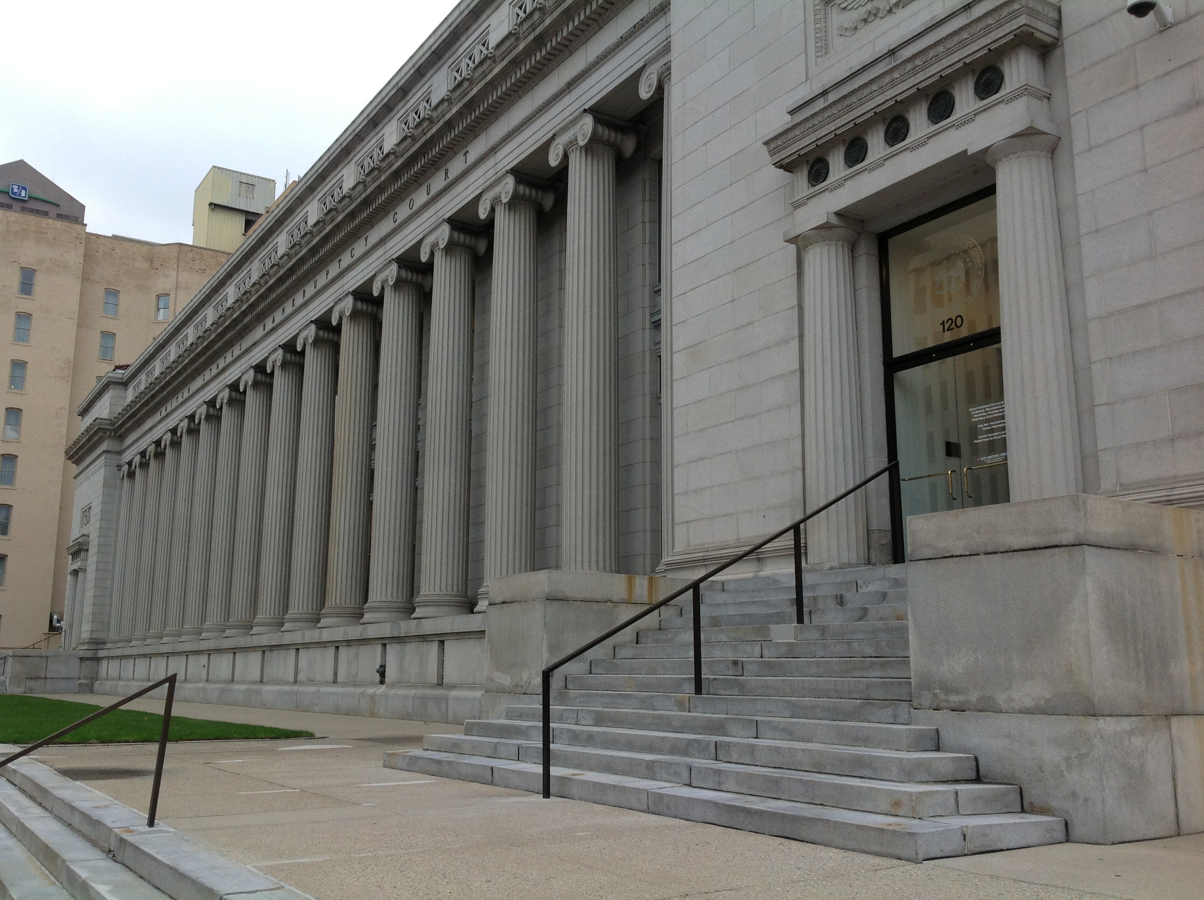



Thank You
We don’t just guide you through the legal process — we open doors to new beginnings. Let us help you turn your journey into a success story.
CONSULT NOW
+91-9657500008
www.justandtrueimmigration.com

